Slide 1

How to make your Vision come true?
Romans 12:10-11
Ptr. ROD LAGO

Slide 2

What is a VISION?
Vision is the eye of Faith to see the invisible. It is a decision to make it happen and the burden to share it with others.

Slide 3
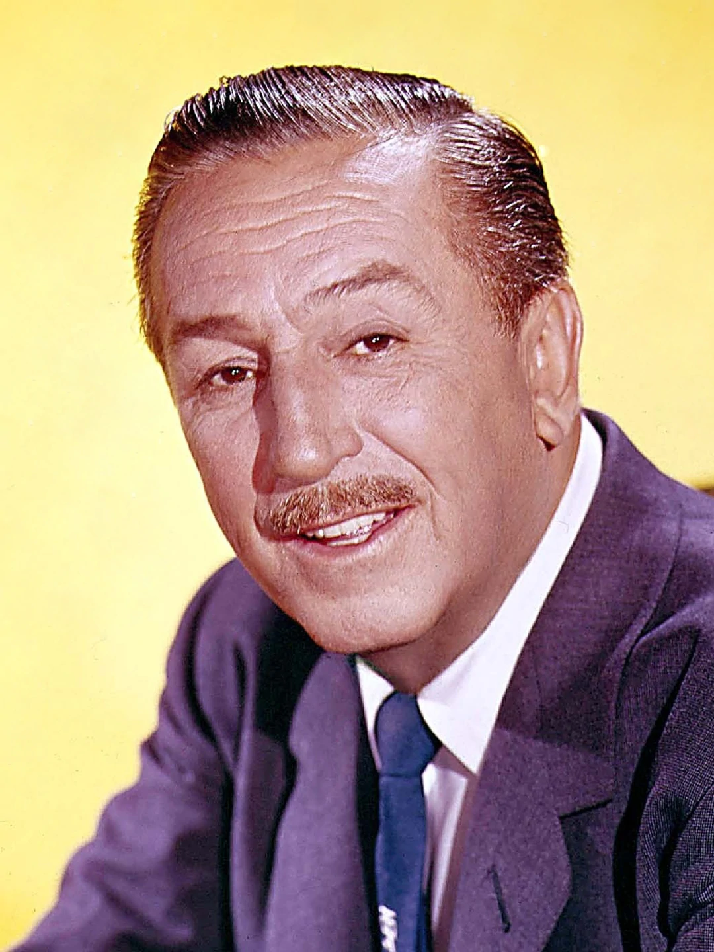
Picture of WALT Disney

Slide 4

I. GET the VISION for your life. Habakkuk 2:2

Slide 5

Three Characteristics of a God given Vision.
Big and Beautiful Visions will come true.
Your spirit is Rejoicing, Excited and On Fire not in Troubled.
No matter what it takes “IT WILL COME TO PASS”

Slide 6

II. SEEK GOD with All your HEART. – Jeremiah 29:11-13

Slide 7
VISION makes come true when we seek Him with All our hearts through Intensive Prayer.

Slide 8
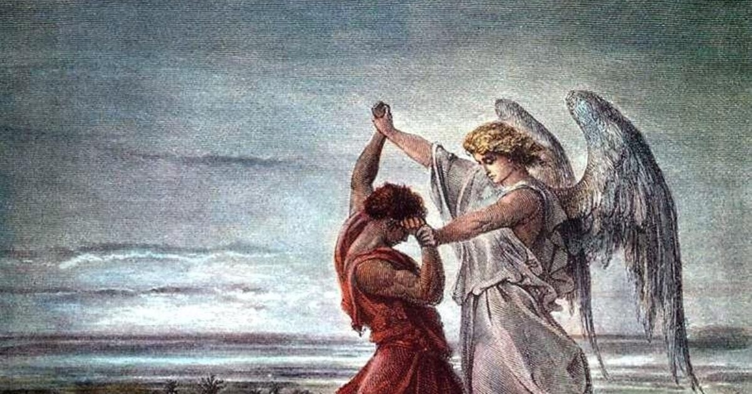
Life of Jacob

Slide 9

III. DECIDE to make the TRADE-OFF

Slide 10

GOOD TRADE-OFF. – Parable of Jesus. Matthew 13:44-46
BAD TRADE-OFF. – Example of Demas. 2 Timothy 4:10
GREAT TRADE-OFF. – Example of Moses. Hebrews 11:24-26

Slide 11

IV. VISUALIZE your VISION. Ephesians 3:20

Slide 12
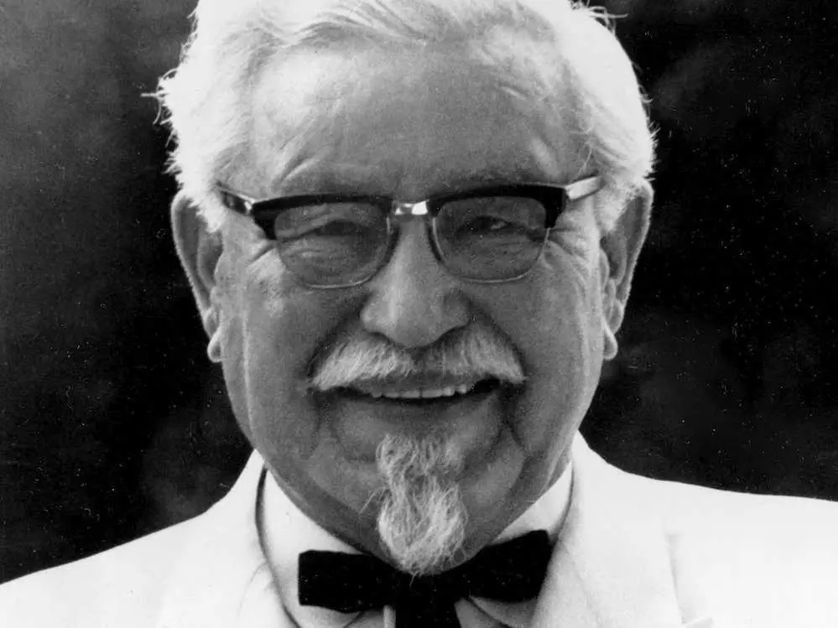
Life of founder of Kentucky fried chicken

Slide 13
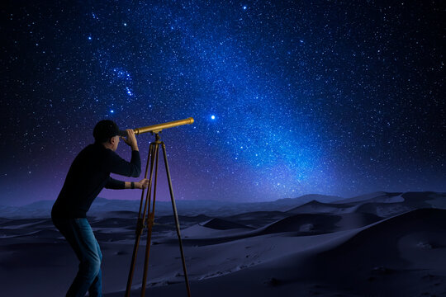
V. BEGIN to ACTUALIZE your VISION. Philippians 2:13

Slide 14
How to Actualize your Vision?
Keep on Moving and Working towards into the Direction of your Vision.
Focus your mind and energy towards goals that will bring you closer to the fulfillment of your Vision.
Intentionally Engage yourself in every activities and work that are relevant to your Vision.

Slide 15
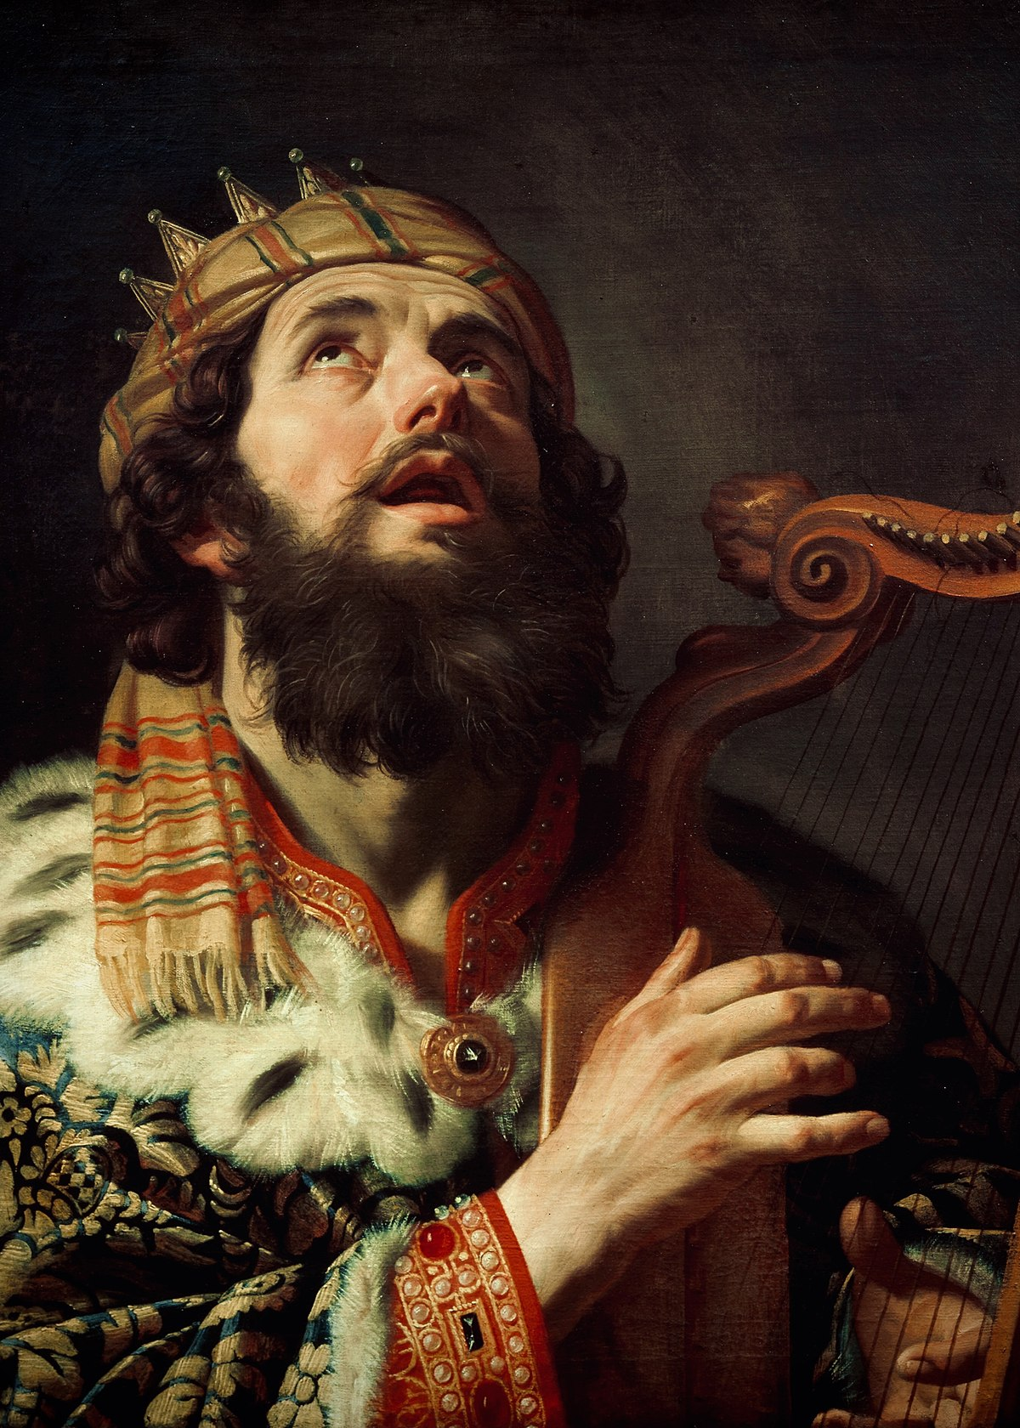
Life of King David

Slide 16

VI. MOTIVATE yourself to WORK in PURSUING your VISION.

Slide 17
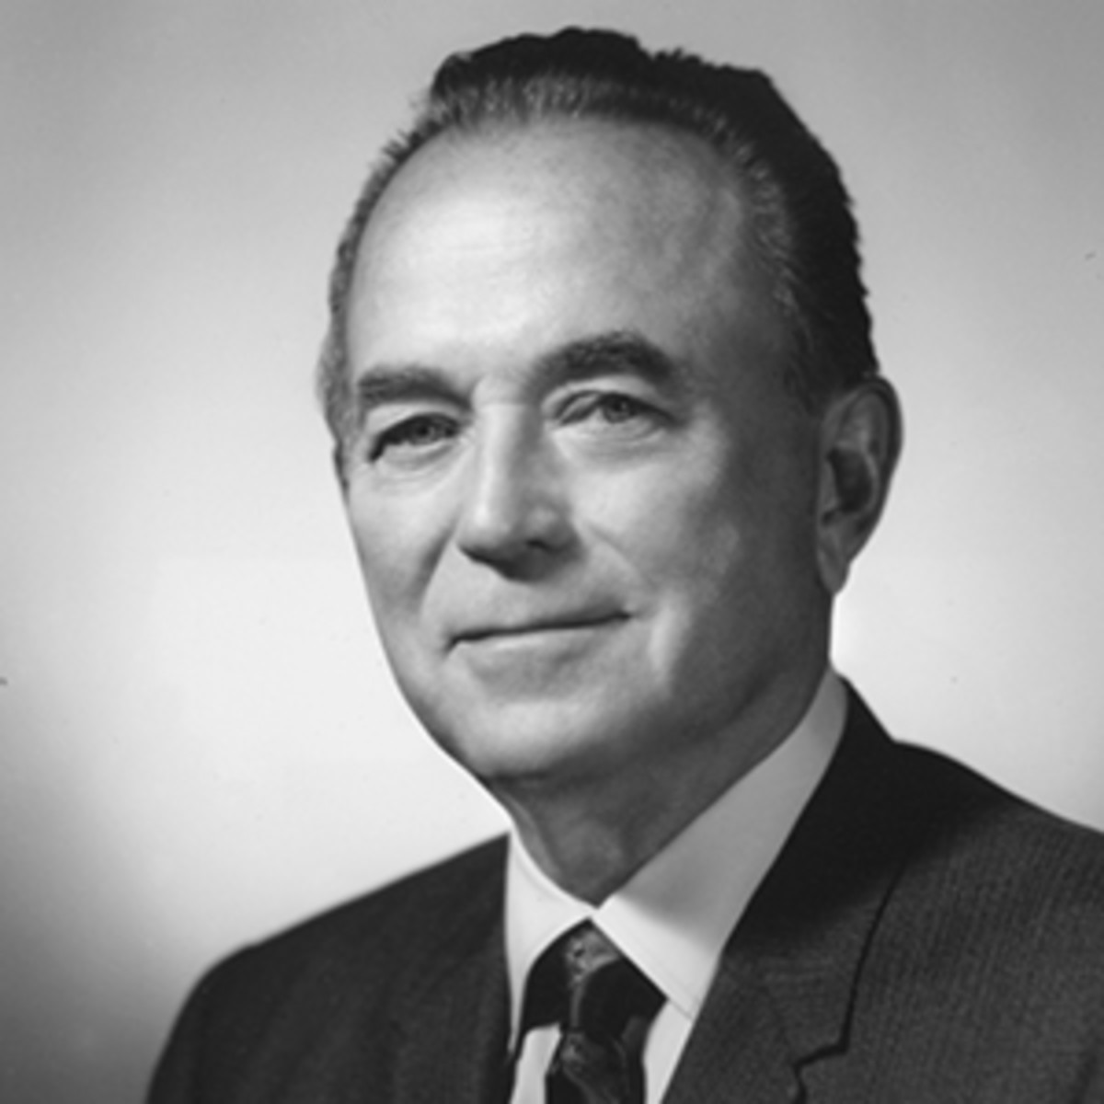
FOUNDER of MC DONALS – RAY CRACK

Slide 18
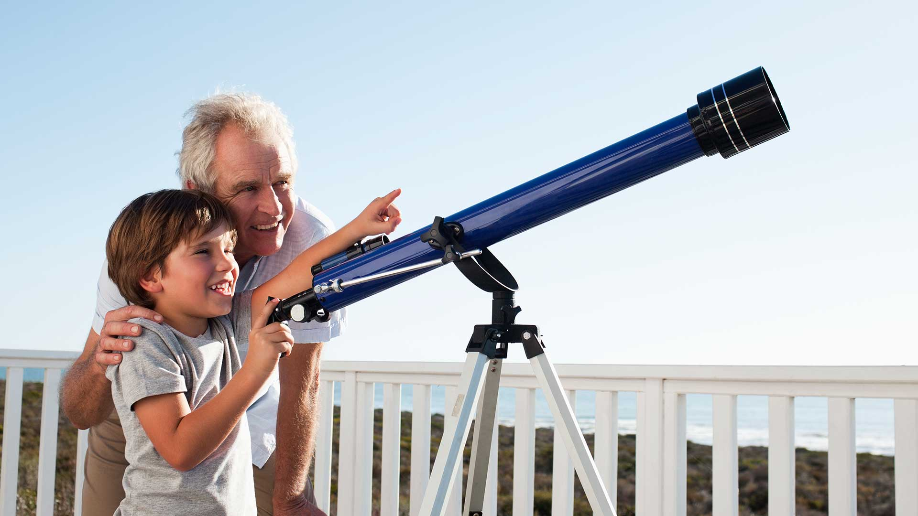
VII. SHARE your VISION to KEY PEOPLE of your life.

Slide 19
Share your Vision with people……
You know.
Who trust you.
Who Inspire and Encourage and Support you.
Who are not afraid to remind you and sometimes rebuke you.
Who Pray for you.

Slide 20

VIII. PATIENTLY WAIT for the VISION come true. Habakkuk 2:3, Isaiah 40:30-31

Slide 21

Life of Joseph the Dreamer

Slide 22

How to make your Vision come true?
Get the Vision for your life.
Seek God with All your Heart.
Decide to make the Trade-Off.
Visualize your Vision.
Begin to Actualize your Vision.
Motivate yourself to work in Pursuing your Vision.
Share your Vision to Key people of your life.
Patiently wait for the Vision come true.

